Slide 1


DEPARTMENT OF COMPUTER SCIENCE AND ENGINEERING
CSB1332 & DESIGN PROJECT
END SEMESTER PRACTICAL EXAMINATION – MAY ( 2026)
Batch No: 04
Date: 05 / 05 / 2026
Session: FN

Slide 2
E-COMMERCE ADMIN LOGIN WITH DECOY PROTECTION
Guide Name:
MS.V.SOWMIYA M.E,
Team Members:
1. ROHINI D (2303811710422131)
2. SHEEBA S (2303811710422145)
3. SINDHUJA S (2303811710422150)
4. SRINITHI D (2303811710422156)

Slide 3
OBJECTIVE OF THE PROJECT
To enhance the security of the e-commerce admin panel by implementing a decoy login protection mechanism
To detect unauthorized login attempts, mislead attackers into a fake admin dashboard, and protect the real database .

Slide 4
INTRODUCTION
ShopNova Admin Panel is a secure e-commerce admin system with OTP-based authentication, brute-force protection, and a decoy dashboard to detect intrusions.
It demonstrates modern security techniques like multi-factor authentication and honeypots to safeguard sensitive business data.

Slide 5
LITERATURE SURVEY
TITLE OF PAPER | AUTHOR(S) | PAPER GIST | TECHNOLOGY USED
E-Commerce Security Threats, Defenses Against Attacks and Improving Security | H. B. Patel | Published in an Information Technology / Cyber Security related journal (2020) | SQL injection, SSL, firewalls, and intrusion detection systems
The Impact of Exposed Passwords on Honeyword Efficacy (2024) | Z. Huang | Published in a Cybersecurity / Information Security journal (2024) | Web Technology, Database Systems
Container-Based Comprehensive Cyber Deception Honeynet Architecture (2024) | Tianxiang Yu, Yang Xin, Chunyong Zhang | Electronics (2024) | Web Technology (HTML, CSS, JS)
Advancing Cybersecurity with Honeypots and Deception Strategies | Zlatan Morić, Vedran Dakić, Damir Regvart | Informatics (2025) | IoT Sensors, Embedded Systems
Countering AI-Driven Adversaries Using Adaptive Deception Framework | S. S. Abdulsattar | Published in a Cybersecurity / Artificial Intelligence security journal (2025 | Artificial Intelligence, Machine Learning

Slide 6
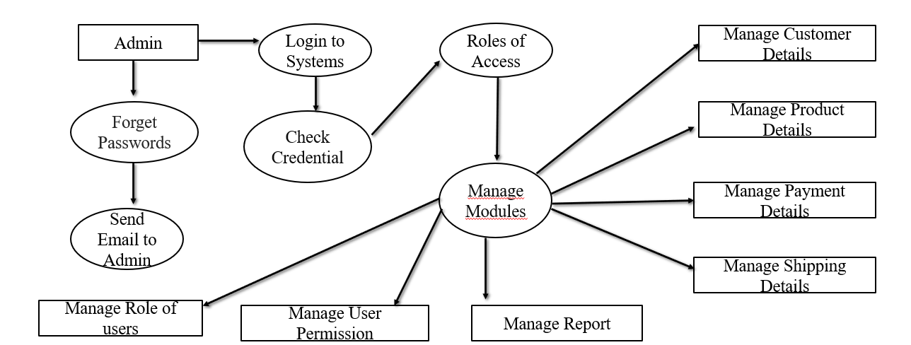
EXISTING SYSTEM ARCHITECTURE

Slide 7
PROBLEM IDENTIFICAITON
The admin login page is publicly accessible, making it vulnerable to attacks such as phishing, brute-force attempts, and data leaks that can lead to stolen credentials.
The system relies only on username and password authentication, which increases the risk of unauthorized access to sensitive data. There is no advanced security mechanism in place, such as suspicious login detection or intrusion monitoring, to prevent or detect such attacks.

Slide 8
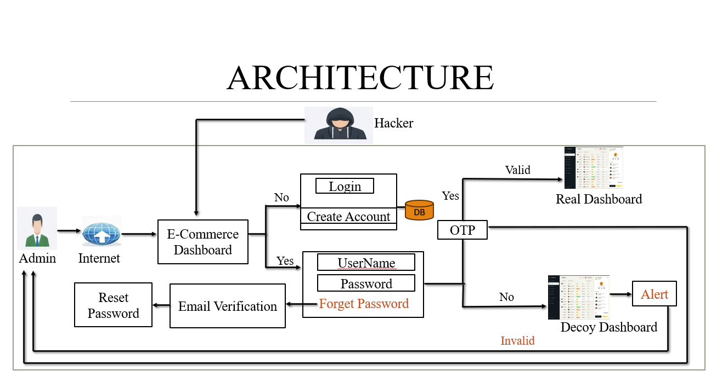
PROPOSED SYSTEM ARCHITECTURE

Slide 9
SOFTWARE AND HARDWARE REQUIREMENTS
HARDWARE
Processor : Basic (Intel i3 or above)
RAM : 4 GB minimum
Storage : 100 MB free space
Internet : Required
Keyboard & Mouse
SOFTWARE
Operating System: Windows
Web Browser: Chrome
EmailJS Account (for OTP & alerts)
Internet Connection (for APIs & fonts)
Frontend: HTML, CSS, JavaScript

Slide 10
MODULES
Login Portal Module
Authentication Module
Password Recovery Module
Real Admin Dashboard Module
Decoy Dashboard Module
Alert Module

Slide 11
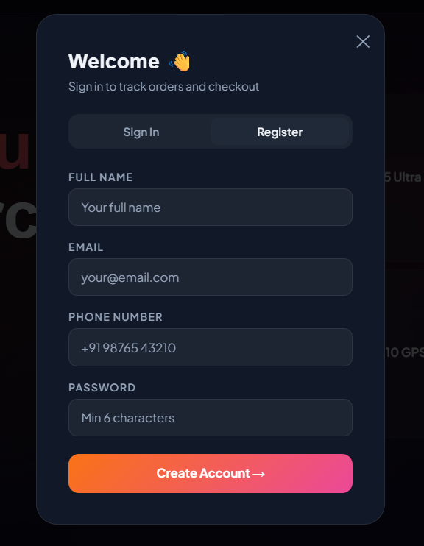
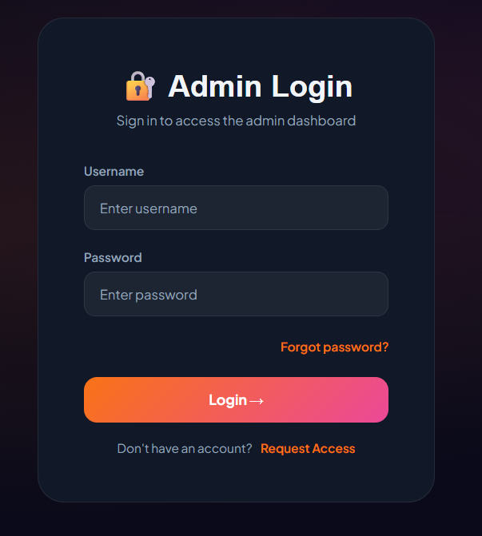
IMPLEMENTATION OF MODULE - 1
1. Login Portal Module
Allows users/admin to log in using username/email and password.
Validates credentials with backend database.
Ensures only authorized users can access the system.

Slide 12
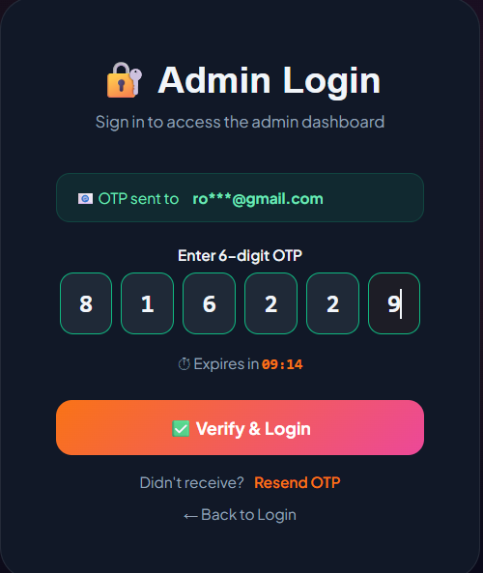
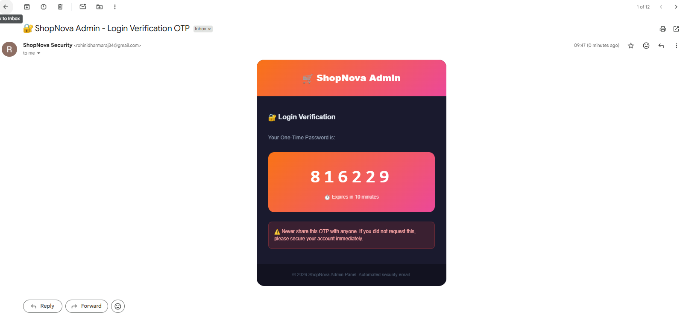
IMPLEMENTATION OF MODULE - 2
2. Authentication Module
Validates user credentials (username/email and password).
Adds an extra layer of protection using OTP verification.
Grants access to the dashboard only for authorized users and blocks unauthorized attempts.

Slide 13
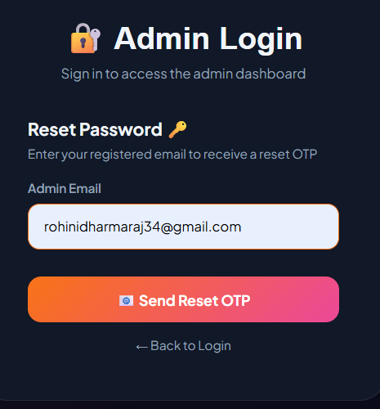
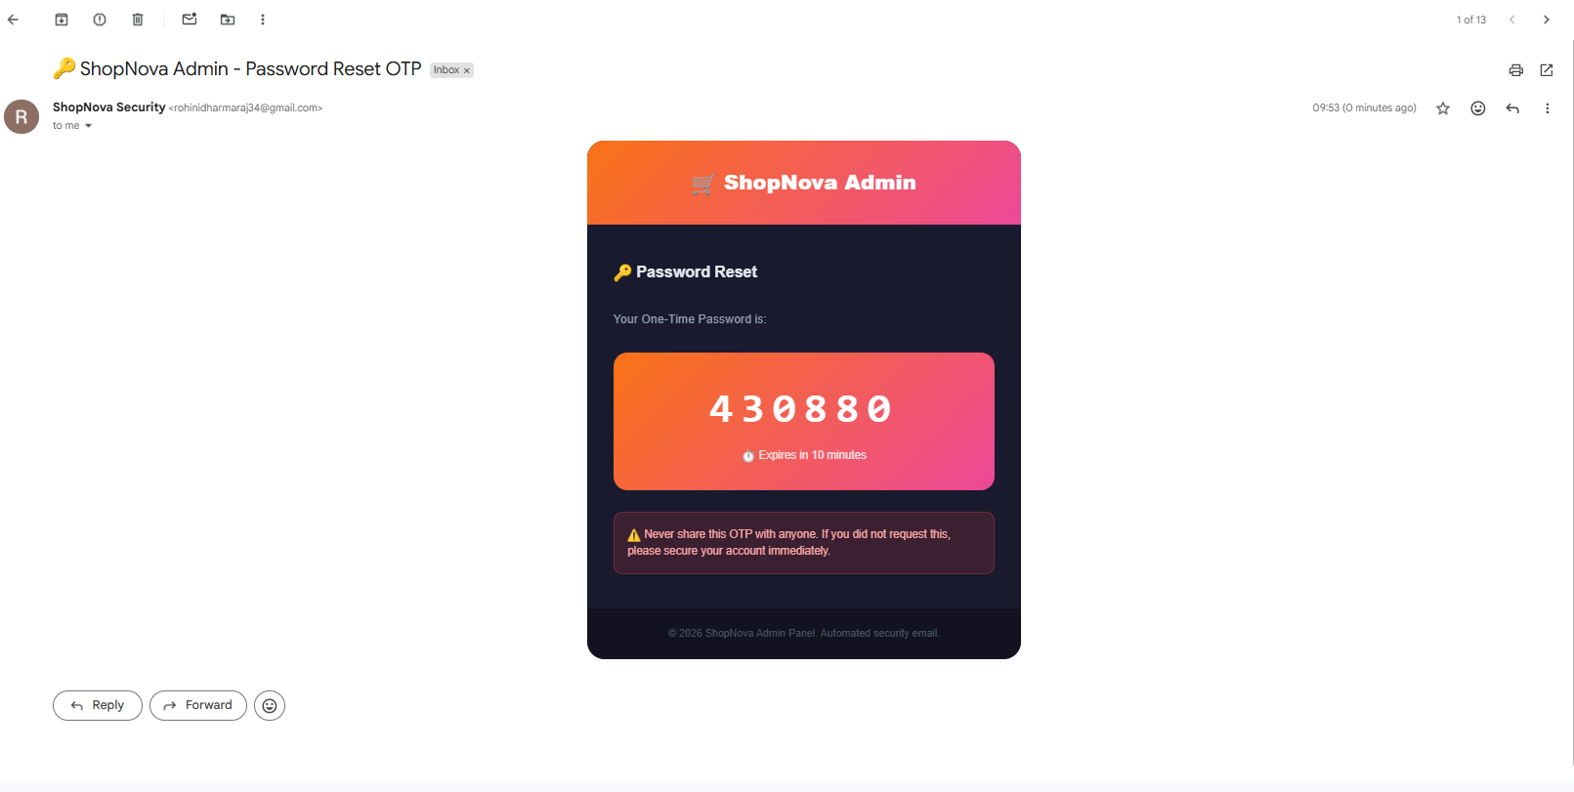
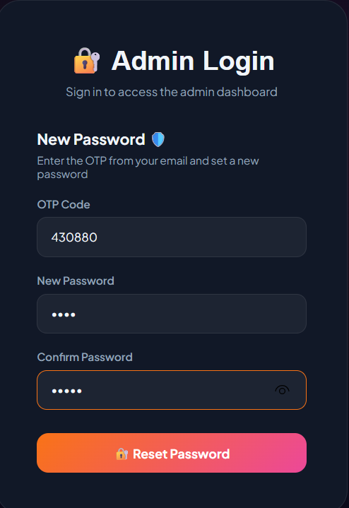
IMPLEMENTATION OF MODULE - 3
3. Password Recovery Module
User selects “Forgot Password” and enters the registered email.
System sends an OTP to the email for verification.
After successful OTP verification, the user can set a new password and log in securely.

Slide 14
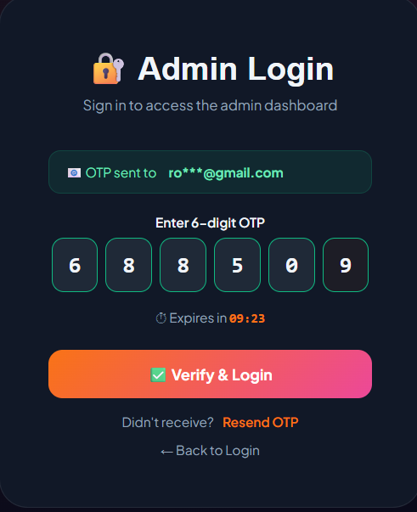
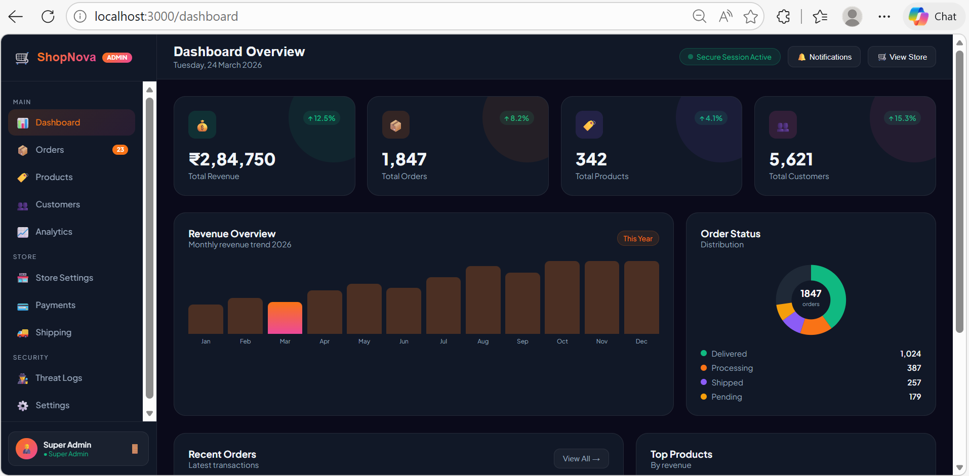
IMPLEMENTATION OF MODULE - 4
4. Real Admin Dashboard Module
Displays overall system details like total users, login activity, and security logs.
Allows admin to monitor system performance and user activities in real time.
Provides access to important features like viewing logs, managing data, and tracking security events.

Slide 15
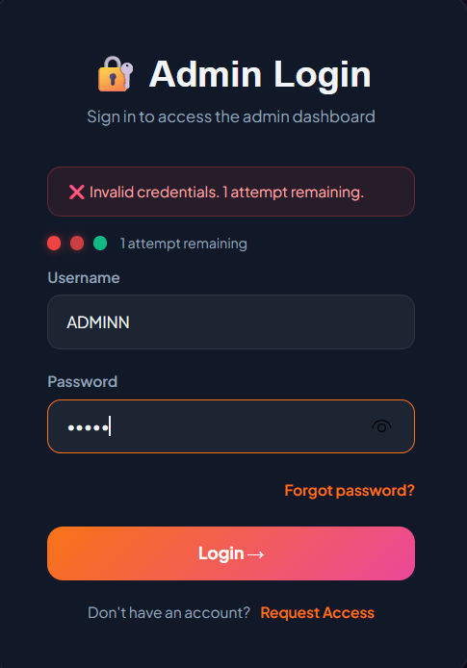
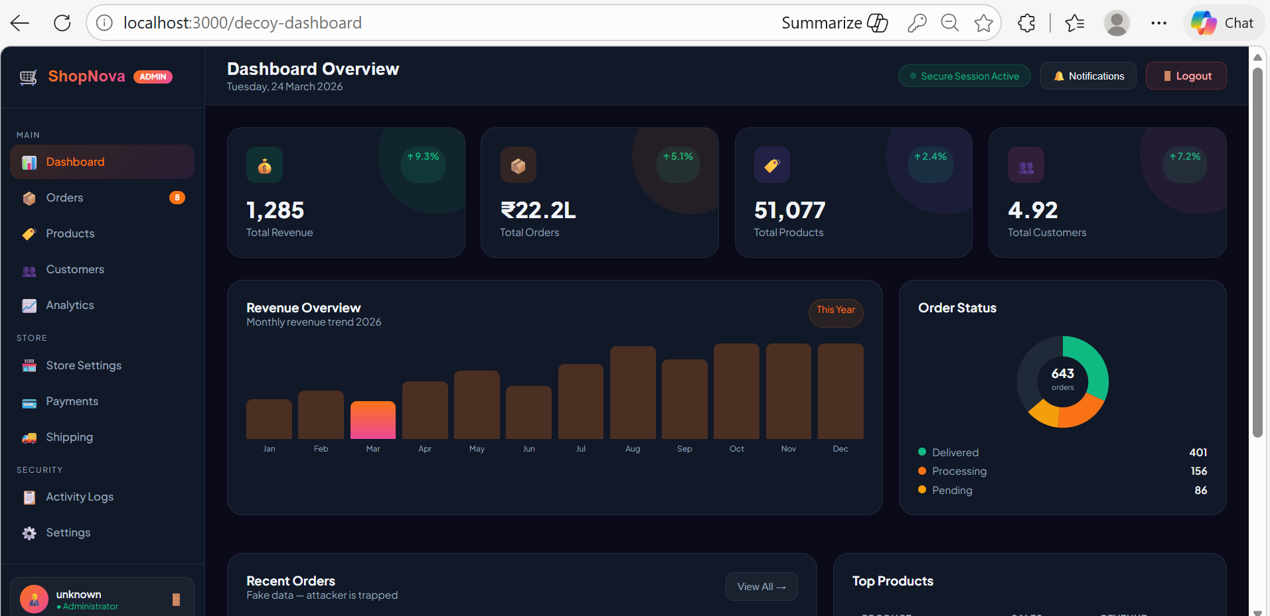
IMPLEMENTATION OF MODULE - 5
5. Decoy Dashboard Module
After 3 failed login attempts, the system redirects the user to a fake (decoy) dashboard.
It captures attacker details like IP address, device, and browser information.
Helps enhance security by misleading attackers and storing their activity in security logs.

Slide 16
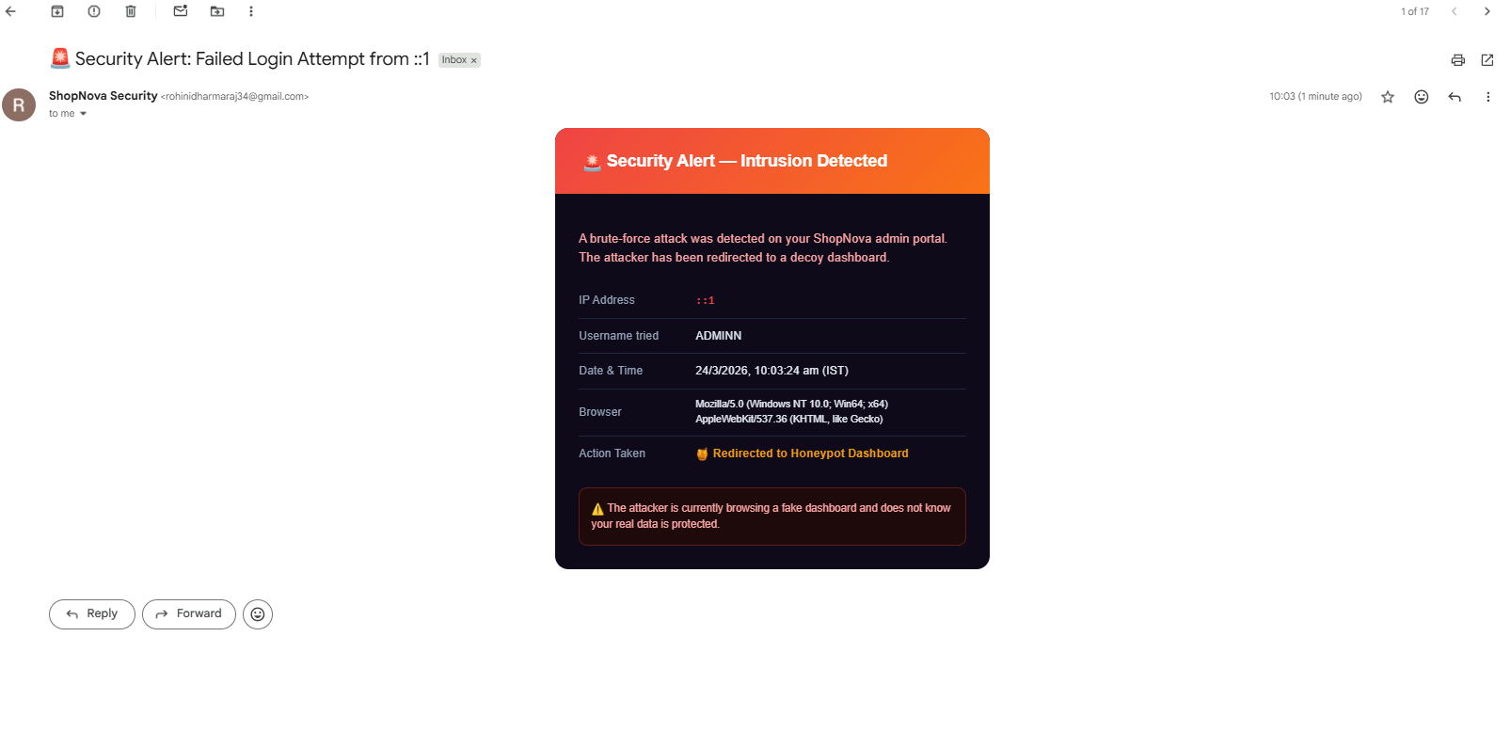
IMPLEMENTATION OF MODULE – 6
6. Alert Module
Sends security alerts to the admin when suspicious activities occur (e.g., multiple failed login attempts).
Notifies through email or system notifications for quick awareness.
Helps the admin take immediate action to protect the system and user data.

Slide 17
CONCLUSION
ShopNova Admin Panel shows how layered security (OTP, brute-force protection, and decoy dashboard) helps prevent unauthorized access.
It ensures admins are alerted about suspicious activity while maintaining strong and efficient protection for e-commerce systems

Slide 18
FUTURE ENHANCEMENTS
Future improvements include real-time IP tracking and geolocation to identify attackers more accurately.
Integrating databases like Firebase or MongoDB can enable user management and activity logs, while adding biometric authentication can further enhance security beyond OTP.

